Slide 1

RRHH-system
Course: Base de Datos ICIFF004
Workshop 2
Simplifying HR Management, One Click at a Time
by
Alan Silva, Dante Quezada and Lucas Brown
Professor in charge: Cristhian Aguilera
November 29th, 2024

Slide 2

What is HR?
This department manages:
Employees
Contracts
Remuneration
Training
Evaluations
Vacations
Health Plans, Pension Funds
Human Resources (HR) plays a pivotal role in managing an organization’s most valuable asset: its people.
2/25

Slide 3

Challenges HR faces:
Manual processes – All information is managed via time-consuming tasks for registering contracts, defining employees, etc.
Inefficiencies - Lack of a defined structure to so store and relate data on the company.
Human errors – Mistakes in calculations, saving the data, deleting vital information the government would need.
3/25

Slide 4
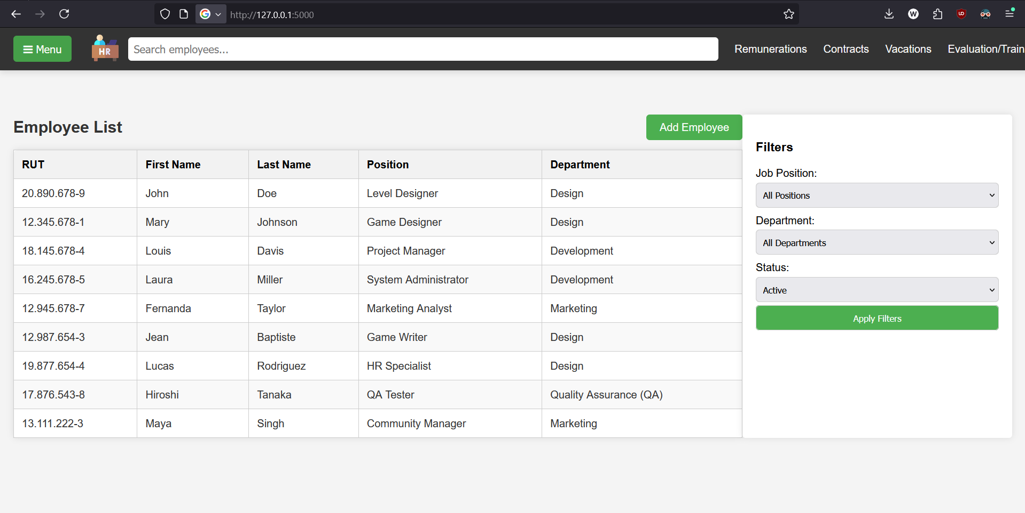
Solution
http://172.214.209.5:5000/
(imposed by this course)
4/25

Slide 5
(HERE WE SHOW THE WEBAPP)
5/25

Slide 6








Key Technologies
6/25

Slide 7
Python is the primary programming language used for developing this application. Known for its simplicity and versatility, it enables rapid development and seamless integration with various tools and libraries.
Flask is a lightweight web framework for Python. It is used to handle routing, manage HTTP requests, and render HTML templates, making it ideal for building scalable and dynamic web applications.
SQLAlchemy is an Object-Relational Mapping (ORM) library for Python. It simplifies database interactions by allowing us to work with Python objects instead of raw SQL queries, ensuring efficient and readable database management.
7/25

Slide 8

MySQL is the database used in this project to store all the HR-related data, such as employee records and vacation details. It allows the application to easily retrieve and store information in a structured way.
Docker is used in this project to make sure that the application runs the same way on every machine and helps to connect the application to the MySQL database securely and reliably by managing the necessary ports and network settings. Docker helps ensure the MySQL version used by all team members is the same, making the development process smoother and avoiding compatibility issues.
8/25

Slide 9

HTML is the foundation of any webpage. It defines the structure and content of the page, such as headings, paragraphs, images, and links. In other words, HTML gives the page its basic framework.
CSS is used to style the HTML content, giving it a visually appealing layout, colors, fonts, and other design elements. It controls the appearance of the page, like the spacing, borders, and alignment. Without CSS, the page would just be plain, unstyled content.
JavaScript is used to add interactivity to the webpage. It allows for actions like responding to user input (clicks, form submissions), updating the content dynamically without refreshing the page, or handling events like showing a pop-up.
9/25

Slide 10
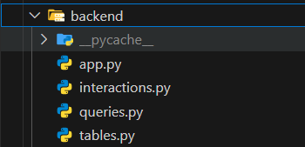
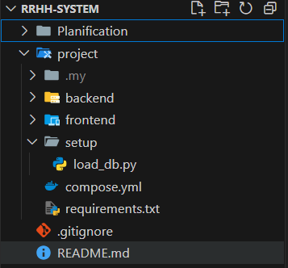
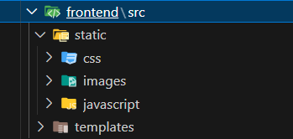
Folder structure
10/25

Slide 11
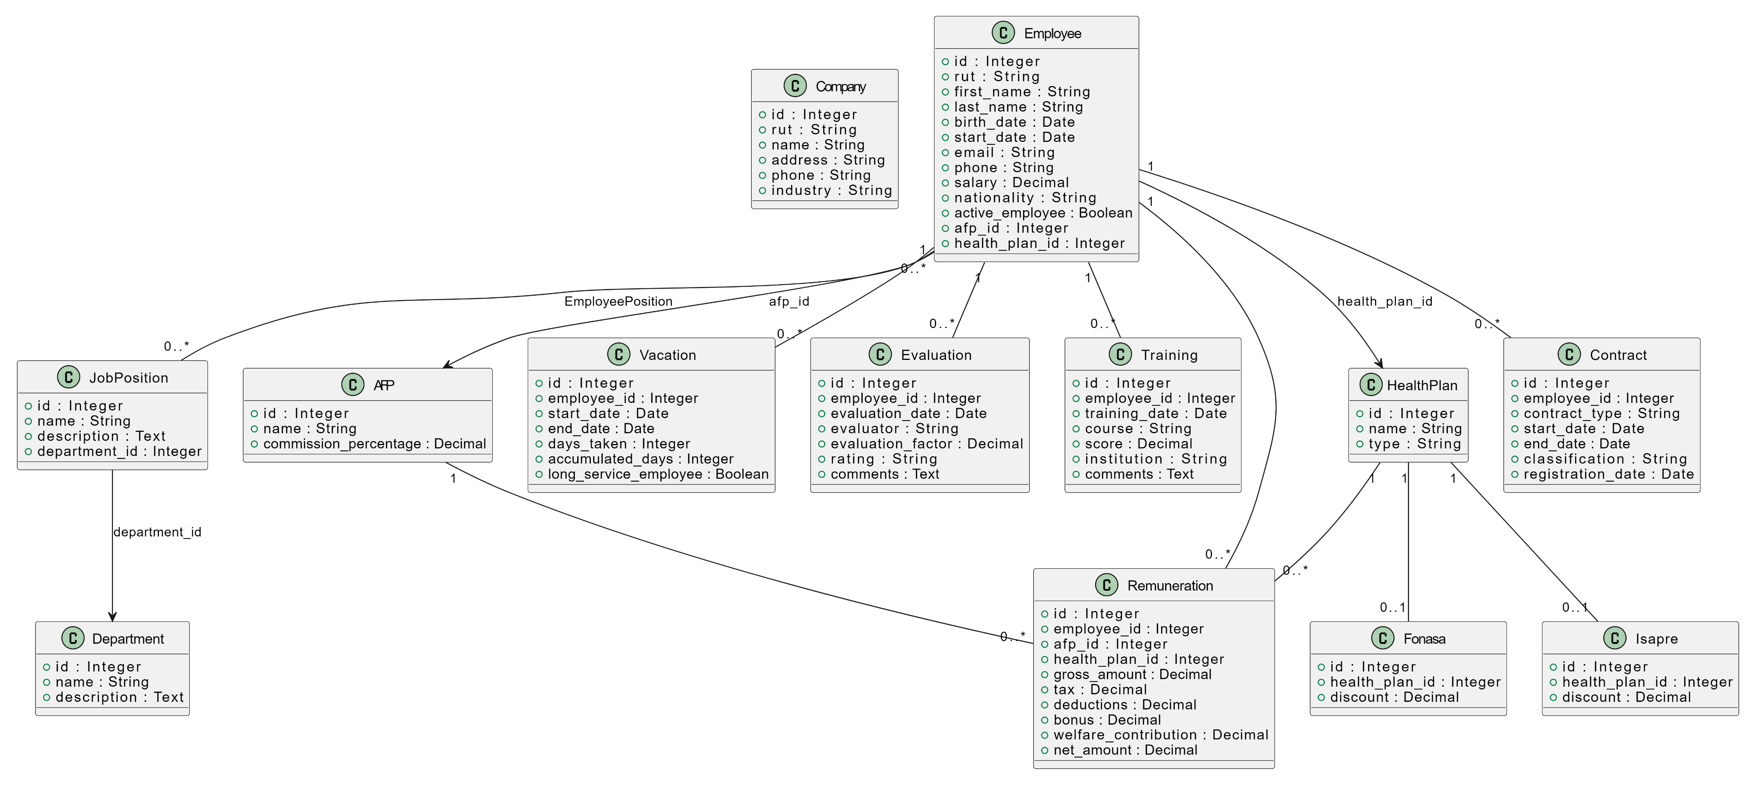
Data Model
11/25

Slide 12
queries.py, tables.py,
load_db.py
DB Connection
# Load the MySQL root password from environment variables
mysql_root_password = os.getenv('MYSQL_ROOT_PASSWORD', 'default_root_pass’)
# Fallback in case the env variable isn't set
# You can set it up by doing: export MYSQL_ROOT_PASSWORD=a301rrhh
config = {
'host': 'localhost',
'database_name': 'hr',
'user': 'root',
'password': mysql_root_password
}
engine = create_engine(f'mysql+pymysql://{config["user"]}:
{config["password"]}@{config["host"]}', echo=True)
with engine.connect() as connection:
connection.execute(text("CREATE DATABASE IF NOT EXISTS hr"))
engine = create_engine(f'mysql+pymysql://{config["user"]}:
{config["password"]}@{config["host"]}/{config["database_name"]}', echo=True)
12/25

Slide 13
CRUD
Create
Read
Update
Delete
Interactions.py
Queries.py
246 lines of code
362 lines of code
618 lines of code (aprox.)
13/25

Slide 14
CRUD
Interactions.py
Queries.py
Create – Queries that create new entries in the database.
Update – Queries that edit entries in the database.
Delete – None present
Read – All queries that fetch information from the database for it to show up visually on the webapp.
14/25
Notes:
As Lucas was saying, our CRUD structure is subdivided into two files:
Interactions: This file stores the functions that create, update, and delete data from the database.
Queries: This file contains functions that only retrieve information from the database.

Slide 15
interactions.py
Interactions.py
def add_employee_to_db(session, employee_data):
"""Add an employee to the database."""
def deactivate_employee(session, employee_id):
"""Deactivate an employee by setting active_employee to False."""
def update_employee(session, data):
"""Update an employee's information."""
def add_company_to_db(session, company_data):
"""Adds a new company to the database using the provided data."""
def add_remuneration(session, remuneration_data):
"""Add a remuneration for an employee."""
def add_contract(session, contract_data):
"""Adds a new contract to the database"""
15/25
Notes:
Some of the queries that interactions have, are...

Slide 16
queries.py
Queries.py
def all_afps(session):
"""Retrieve all afps and their data."""
def all_health_plans(session):
"""Retrieve all health plans with their respective discounts."""
def all_companies(session):
"""Retrieve all companies and their data."""
def search_employee_by_name_or_rut(search_query, session):
"""Search an employee by name or RUT with flexible matching."""
def get_filtered_employees(…):
"""Get employees filtered by job position and/or department."""
def all_employees(session):
"""Retrieve all employees"""
def get_job_positions(session):
"""Get all job positions."""
def get_departments(session):
"""Get all departments."""
16/25
Notes:
In queries are

Slide 17
app.py
Employee page
@app.route('/employee')
def user():
search_query = request.args.get('search_query')
# Perform the search if there is a search parameter
if search_query:
employee = search_employee_by_name_or_rut(search_query, session)
# Redirect to profile if an employee is found
if employee:
return redirect(url_for('user', id=employee.id)) # Change here to ensure redirection with ?id
return render_template('index.html', error_message="Employee not found") # If not found
# Get the employee ID if there is no search parameter
employee_id = request.args.get('id')
if not employee_id:
# Show message if no employee_id is provided
return render_template('employee.html', error_message="No employee ID provided")
# Get employee information
gi = general_info(session, employee_id)
ad_info = aditional_info(session, employee_id)
if not gi:
return render_template('employee.html', error_message="Employee not found")
17/25
Notes:
Here we have the backend of the employee page. This is the most extensive page in the entire project, as it displays a large amount of information on screen.

Slide 18
queries.py
def aditional_info(session, employee_id):
try:
info = session.query(
Employee.nationality,
Employee.birth_date,
Employee.start_date,
Employee.salary,
Remuneration.net_amount,
HealthPlan.name.label('health_plan'),
AFP.name.label('afp_name')
).select_from(Employee) \
.outerjoin(Remuneration, Employee.id == Remuneration.employee_id) \
.outerjoin(HealthPlan, Remuneration.health_plan_id == HealthPlan.id) \
.outerjoin(AFP, Remuneration.afp_id == AFP.id) \
.filter(Employee.id == employee_id).first() if info:
today = datetime.today().date()
age = (today.year - info[1].year) if info[1] else None
days_since_start = (today - info[2]).days if info[2] else None
net_amount = int(info[4]) if isinstance(info[4], Decimal) else info[4]
return {
'nationality': info[0],
'birth_date': info[1],
'age': age,
'start_date': info[2],
'days_since_start': days_since_start,
'salary': info[3],
'net_amount': net_amount,
'health_plan': info[5] or "No health plan registered",
'afp_name': info[6] or "No AFP registered"
}
except Exception as e:
print(f'Error in aditional_info: {e}')
return None
Employee page
18/25
Notes:
This is one of the sections that shows some additional information, such as nationality, birth date, age, and others.

Slide 19
app.py
Employee page
# Pass the data to the template, including the current contract and job_positions and departments
return render_template(
'employee.html',
employee_id=employee_id,
first_name=first_name,
last_name=last_name,
email=email,
phone=phone,
rut=rut,
position=position,
status=status,
nationality=ad_info.get('nationality', "Not registered"),
birth_date=ad_info.get('birth_date', "Not registered"),
age=ad_info.get('age', "Not available"),
start_date=ad_info.get('start_date', "Not registered"),
days_since_start=ad_info.get('days_since_start', "Not available"),
salary=ad_info.get('salary', "Not registered"),
net_amount=ad_info.get('net_amount', "Not registered"),
health_plan=ad_info.get('health_plan', "Not registered"),
afp_name=ad_info.get('afp_name', "Not registered"),
missing_info=missing_info,
contract=contract_data,
job_positions=job_positions,
departments=departments)
19/25
Notes:
Here have a summary of all the data that the employee page uses

Slide 20
employee.html
Employee page
<head>
<meta charset="UTF-8" />
<meta name="viewport" content="width=device-width, initial-scale=1.0" />
<title>Employee ({{ first_name }} {{ last_name }})</title>
<link rel="stylesheet" href="{{ url_for('static', filename='css/employee.css')}}" />
<link rel="stylesheet" href="https://cdnjs.cloudflare.com/ajax/libs/font-awesome/4.7.0/css/font-awesome.min.css">
</head>
<header>
{% include 'topbar.html' %}
</header>
20/25

Slide 21
employee.html
Employee page
<body class="{{ 'active' if status == 'Active' else 'inactive' }}">
{% if error_message %}
<p class="error-message">{{ error_message }}</p>
{% else %}
<div class="user-general-info-container">
<div>
<div class="photo">
<img src="{{ url_for('static', filename='images/user.png') }}" alt="user-photo" />
<p>{{ first_name }} {{ last_name }}</p> <!-- Show employee name in the photo section -->
</div>
<p>Status: {{ status }}</p>
</div>
<div class="general-info">
<p>Name: {{ first_name }} {{ last_name }}</p>
<p>Email: {{ email }}</p>
<p>Phone number: {{ phone }}</p>
<p>Rut: {{ rut }}</p>
<p>Position: {{ position }}</p>
</div>
<a href="{{ url_for('edit_employee', id=employee_id) }}">
<button class="edit-button">Edit</button>
</a>
</div>
21/25

Slide 22
employee.html
Employee page
<div class="aditional-info-container">
<div class="aditional-info">
<h2>Additional Info</h2>
<p>Net Amount: ${{ net_amount if net_amount else "Not registered" }}</p>
<p>Health Plan: {{ health_plan if health_plan else "Not registered" }}</p>
<p>Afp: {{ afp_name if afp_name else "Not registered" }}</p>
<p>Nationality: {{ nationality if nationality else "Not registered" }}</p>
<p>Birth Date: {{ birth_date if birth_date else "Not registered" }}
{% if age %} (Age: {{ age }}) {% endif %}
</p>
<p>Start Date: {{ start_date if start_date else "Not registered" }}
{% if days_since_start %} (Days since: {{ days_since_start }}) {% endif %}
</p>
<p>AVG Salary: ${{ salary if salary else "Not registered" }}</p>
{% if missing_info %}
<h3>Missing Information:</h3>
<ul>
{% for message in missing_info %}
<li>{{ message }}</li>
{% endfor %}
</ul>
{% endif %}
</div>
</div>
22/25

Slide 23
employee.html
Employee page
<button class="open-button" onclick="openForm()">Add contract</button>
<div class="form-popup" id="myForm">
<div class="form-container">
{% include 'add_contract.html' %}
<button type="button" class="btn cancel" onclick="closeForm()">Close</button>
</div>
<script src="{{ url_for('static', filename='javascript/add_button.js') }}"></script>
</div>
<button class="remove-contract-btn" onclick="openRemoveForm()">Deactivate Employee</button>
<div class="form-popup" id="removeForm">
<div class="form-container">
{% include 'disable_employee.html' %}
<button type="button" class="btn cancel" onclick="closeRemoveForm()">Close</button>
</div>
</div>
<script src="{{ url_for('static', filename='javascript/remove_button.js') }}"></script>
{% endif %}
</body>
23/25

Slide 24
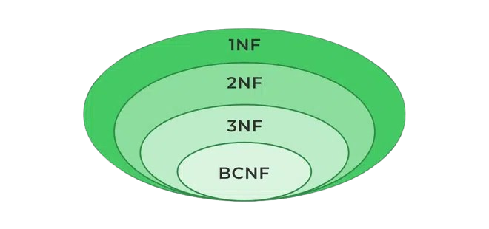


Issues we encountered in the process
Normal form problems within the database.
Lack of coordination while working.
Huge merge conflicts while working with GitHub.
Could have done things differently but was too late to retrace our steps.
24/25

Slide 25


What we gathered from the project
Introduced ourselves to Docker and Azure.
Learned how HTML, CSS and JS work together.
Gained a clear understanding of what to expect in the context of web apps with database integrations.
Reinforced our relational databases knowledge.
25/25

